Slide 1
ANALYSIS OF INDIA'S AIR QUALITY (2015 – 2020)

Slide 2
Data Analytics Project
Team Members :
Narra Abhigna 2021BCS-048
Ravi Jwalana 2021BCS-056
Submitted to :
Dr. Santosh Singh Rathore

Slide 3
Introduction
The project "Analysis of India's Air Quality" focuses on the analysis of air quality data across multiple cities over certain period of time. It aims to understand the patterns, trends, and contributing factors to Air Quality Index(AQI), with a specific emphasis on non-parametric data analysis. The project encompasses various aspects, including correlation between air quality attributes, year-wise comparisons, and the impact of the COVID-19 pandemic on air quality.

Slide 4
Air Quality Index (AQI)
The government uses the Air Quality Index (AQI) to inform the public about the state of the air. Pollutant concentration rises lead to a decline in air quality.
The range of the Indian AQI, according to the Indian Government (CPCB), is 0-500, with 0 denoting good and 500 denoting severe.
Particulate matter (PM 10 and PM 2.5), carbon monoxide (CO), ozone (O3), nitrogen dioxide (NO2), sulphur dioxide (SO2), ammonia (NH3), and lead (Pb) are the eight main pollutants that must be considered when calculating the AQI.
A minimum of three pollutants' data must be available for the AQI to be calculated, one of which must be PM2.5 or PM10. The AQI, which ranges from 0-500, has varying concentrations of each pollutant and corresponding health impacts.
In 2015, Government of India, together with IIT Kanpur launched the National Air Quality Index. While the earlier measuring index was limited to three indicators, the new index measures eight parameters.

Slide 5
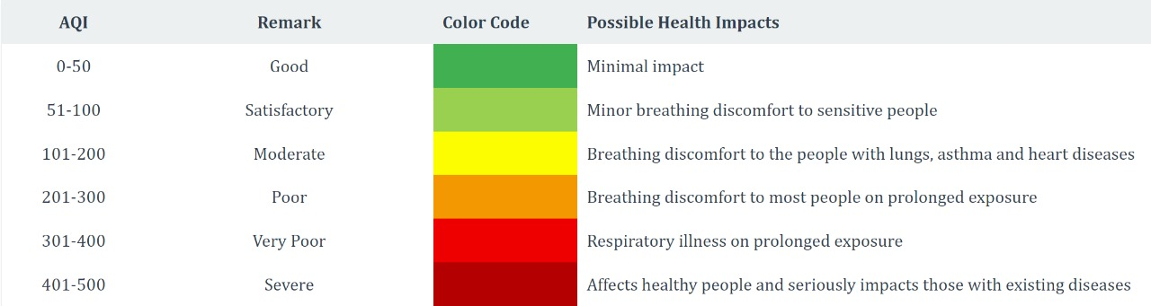
National Air Quality Index given on CPCB (Central Pollution Control Board) India

Slide 6
COLLECTION & UNDERSTANDING
DATASET​

Slide 7
Collection & Understanding Data Set
Dataset used : https://www.kaggle.com/datasets/rohanrao/air-quality-data-in-india. It is dataset of official CPCB soured from kaggle.
It contains 25931 rows(data objects) and 16 columns (attributes)
Number of cities before cleaning: 26
List of cities before cleaning: Ahmedabad, Aizawl, Amaravati, Amritsar, Bengaluru, Bhopal, Brajrajnagar, Chandigarh, Chennai, Coimbatore, Delhi, Ernakulam, Gurugram, Guwahati, Hyderabad, Jaipur, Jorapokhar, Kochi, Kolkata, Lucknow, Mumbai, Patna, Shillong, Talcher, Thiruvananthapuram, Visakhapatnam

Slide 8
Collection & Understanding Data Set
Considered data of pollutants and AQI of India from 2015 to 2020. (including covid era)​
Data set has following attributes:​ City, Date, PM2.5, PM10, NO, NO2, NOx, NH3,​ CO, SO2, O3, Benzene, Toluene, Xylene, AQI, AQI_Bucket.
PM10 is particulate matter 10 micrometres or less in diameter, PM2.5 is particulate matter 2.5 micrometres or less in diameter. PM2.5 is generally described as fine particles. Particles are defined by their diameter for air quality regulatory purposes. Those with a diameter of 10 microns or less (PM10) are inhalable into the lungs and can induce adverse health effects.

Slide 9
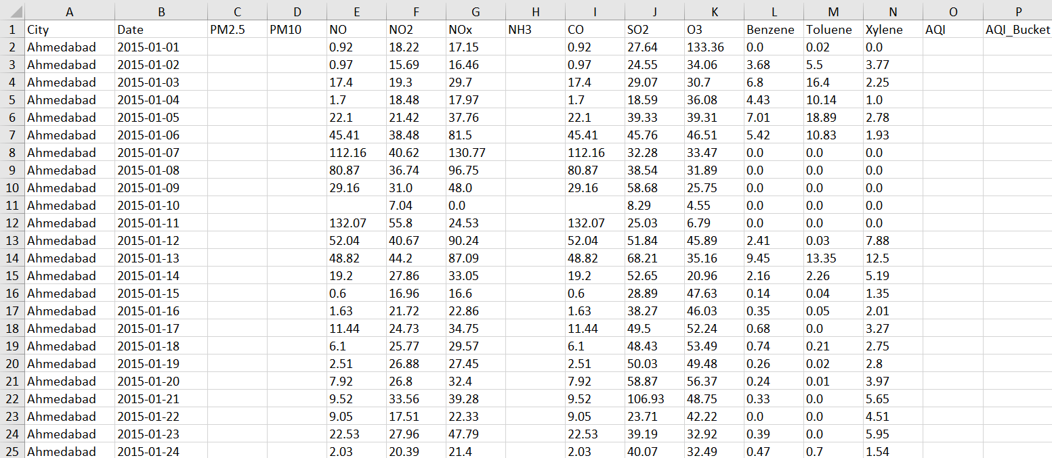
Understanding Data Set

Slide 10
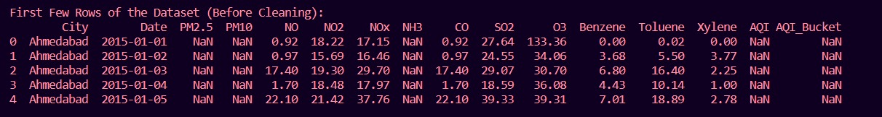
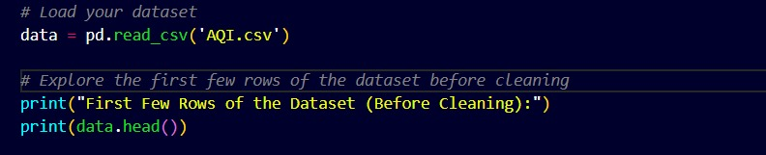
Understanding Data Set

Slide 11
Understanding Data Set
Data Types of each attribute:
City: Nominal
Date: Interval
PM2.5 : Ratio
PM10 : Ratio
NO : Ratio
NO2 : Ratio
NOx : Ratio
NH3 : Ratio
CO : Ratio
SO2 : Ratio
O3 : Ratio
Benzene : Ratio
Toluene : Ratio
Xylene : Ratio
AQI : Ratio
AQI_Bucket : Ordinal

Slide 12
DATA PREPROCESSING

Slide 13
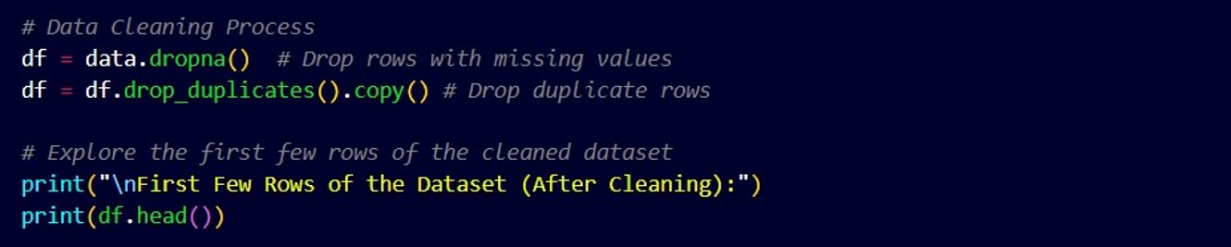
Data Cleaning
As we can see there are some missing values and duplicate rows in our data set it's necessary to remove them before proceeding further in analyzing.

Slide 14
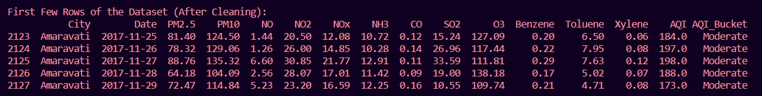
Data Cleaning

Slide 15
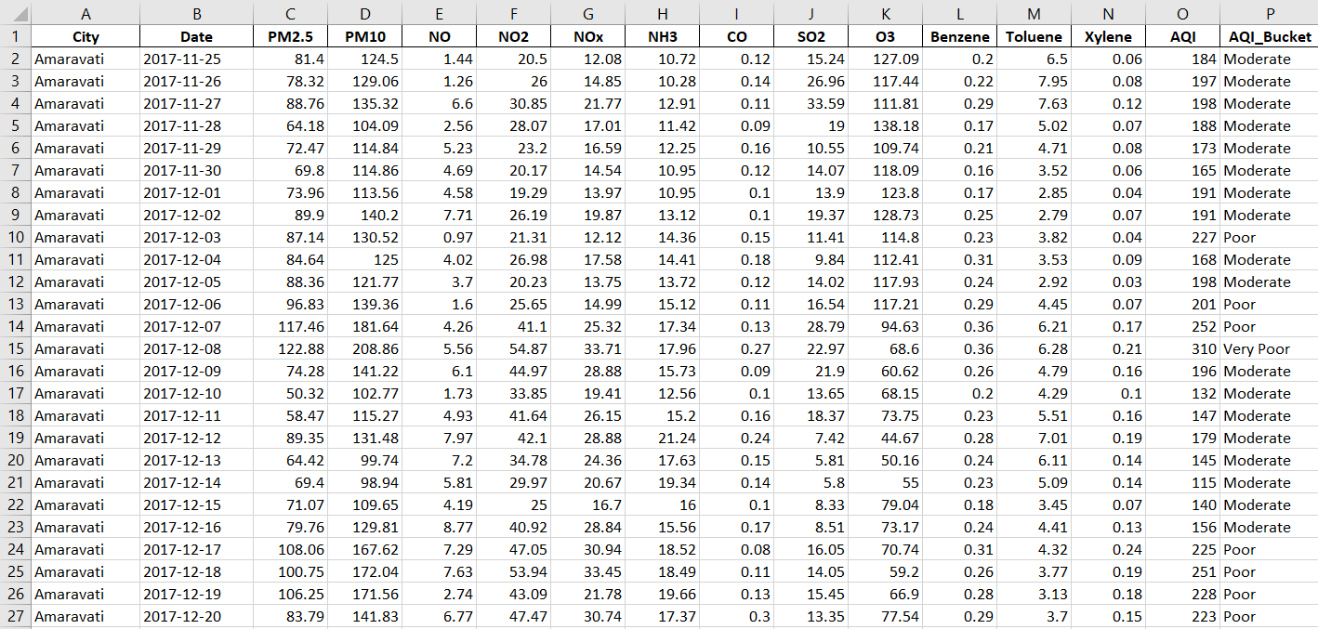
Data Cleaning

Slide 16
Data Cleaning
Number of cities after cleaning: 9
List of cities after cleaning:
'Ahmedabad' 'Aizawl' 'Amaravati' 'Amritsar' 'Bengaluru' 'Bhopal'
'Brajrajnagar' 'Chandigarh' 'Chennai' 'Coimbatore' 'Delhi' 'Ernakulam'
'Gurugram' 'Guwahati' 'Hyderabad' 'Jaipur' 'Jorapokhar' 'Kochi' 'Kolkata'
'Lucknow' 'Mumbai' 'Patna' 'Shillong' 'Talcher' 'Thiruvananthapuram'
'Visakhapatnam'

Slide 17
Inferences

Slide 18
Inference1
I)Finding correlation between attributes:
Using Q-Q plots we have observed that the data is non-parametric and then applied an non-parametric correlation method Spearmon Correlation coefficient to find the correlation between every pair of attributes and represented correlation values in the form of heatmap.
In heatmap we can observe that all correlation values are positive representing that all attributes are positively correlated.
Coming to AQI all attributes have positive correlation with AQI representing increase in any pollutant concentration results in increase in AQI value.
We can also interpret that PM2.5 & PM10 have higher correlation values indicating among all pollutants these two (PM2.5 & PM10) contribute more to AQI value.

Slide 19
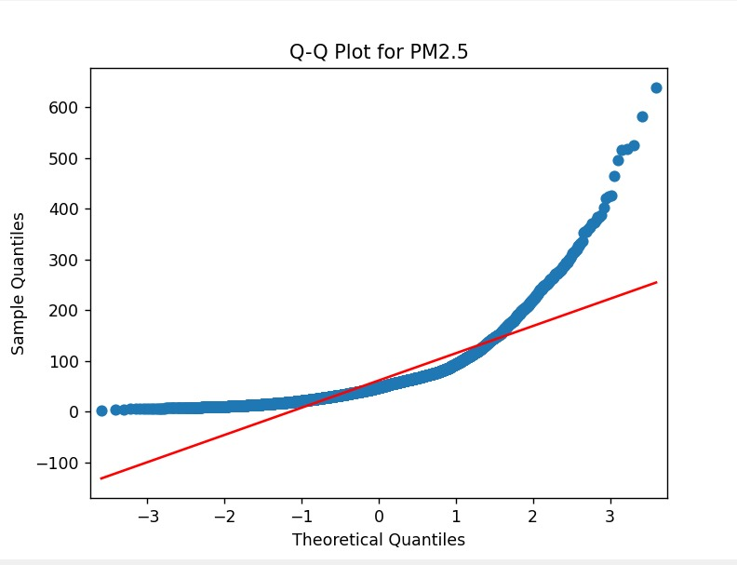
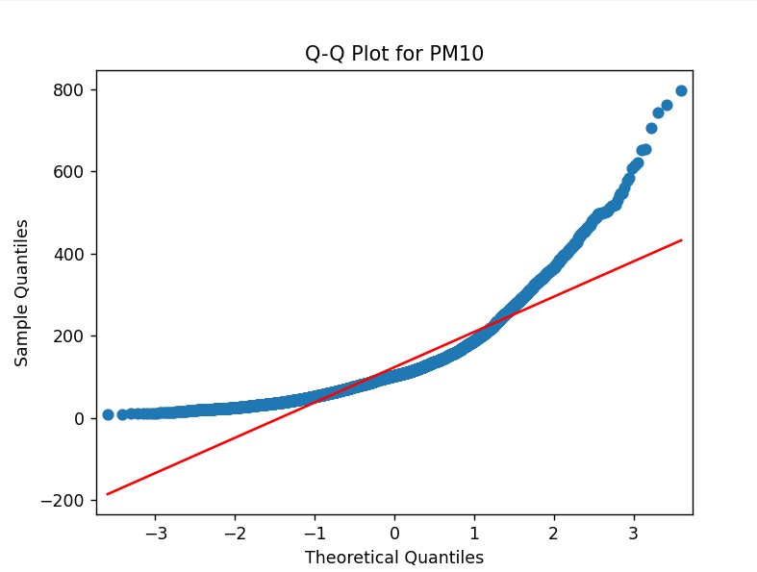
Q-Q Plots

Slide 20
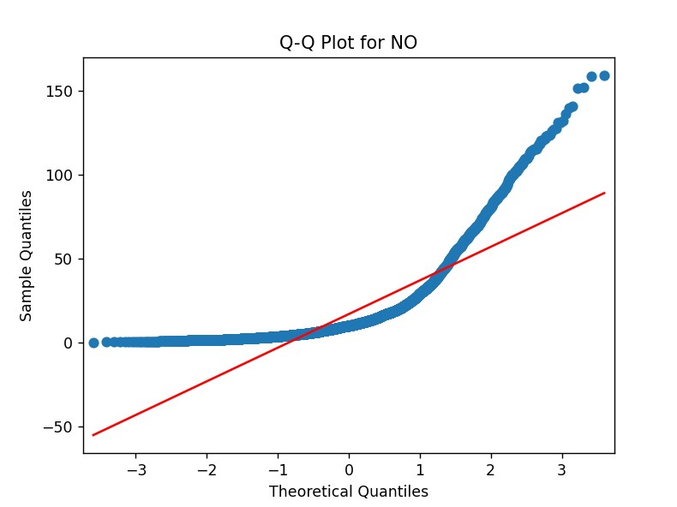
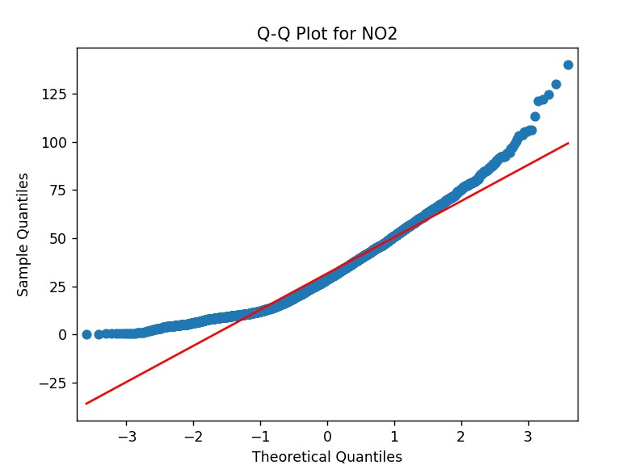
Q-Q Plots

Slide 21
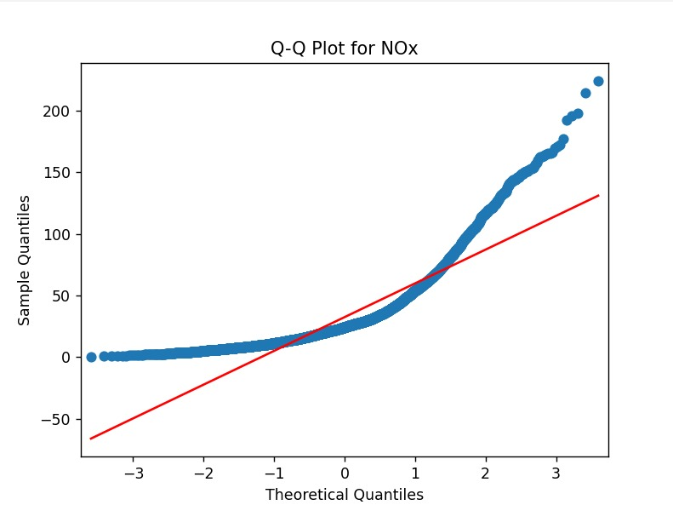
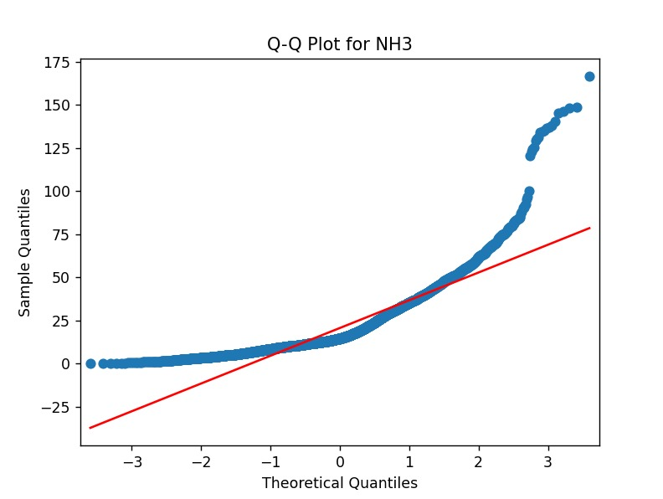
Q-Q Plots

Slide 22
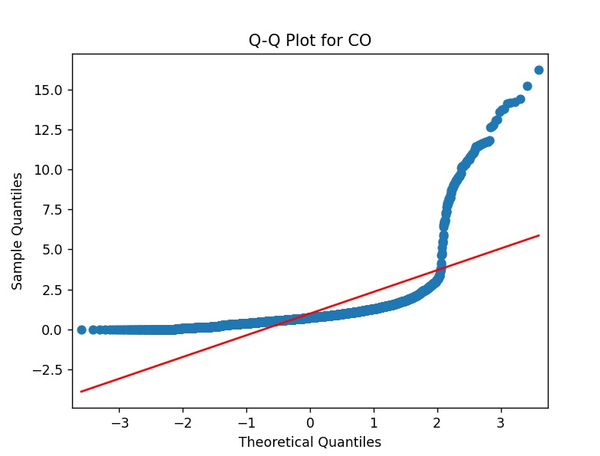
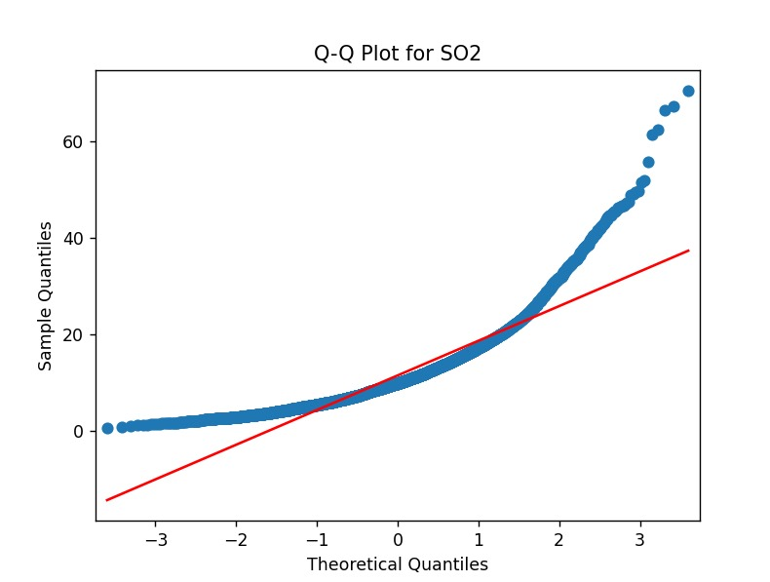
Q-Q Plots

Slide 23
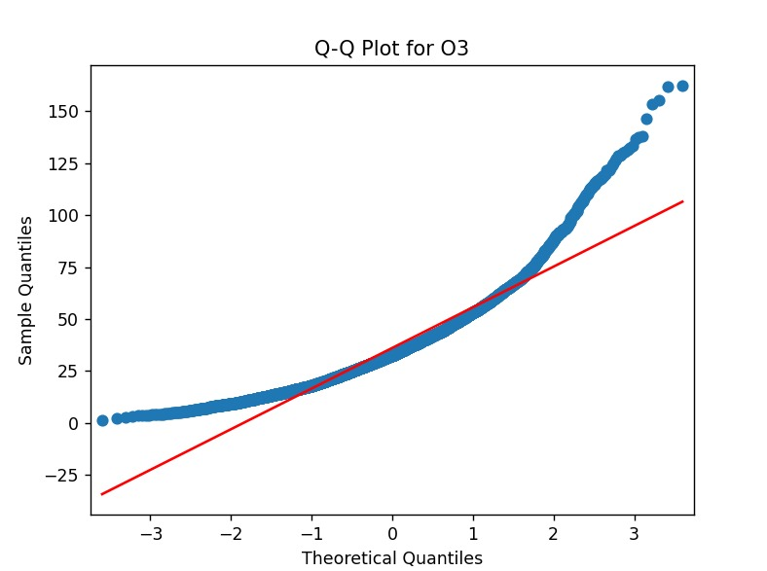
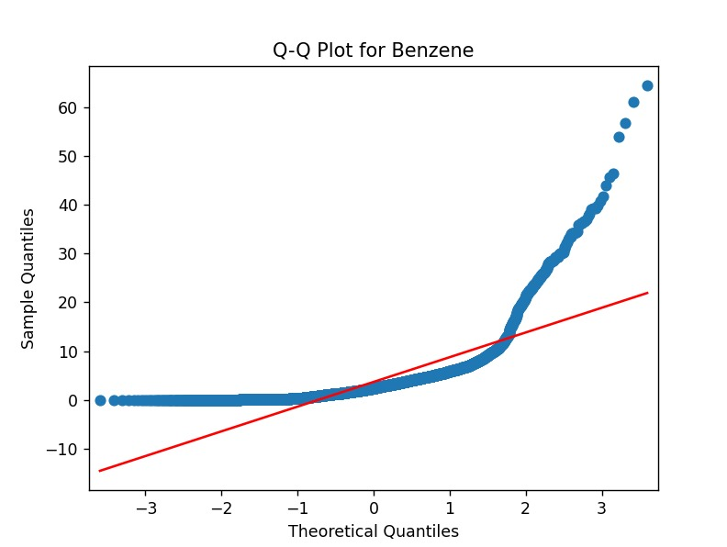
Q-Q Plots

Slide 24
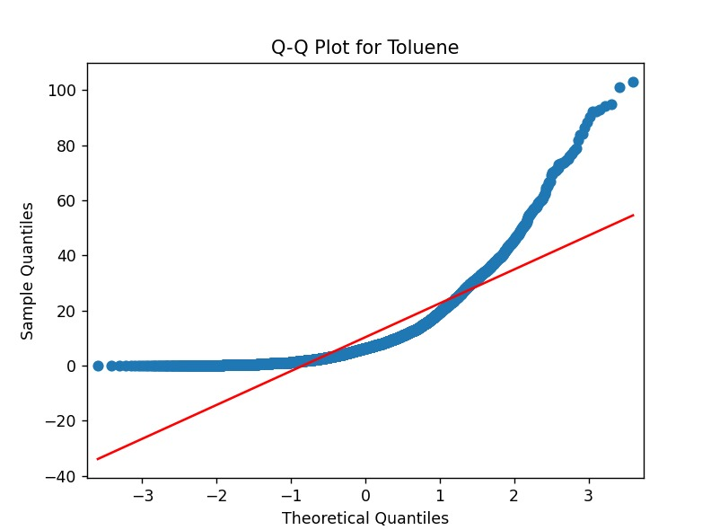
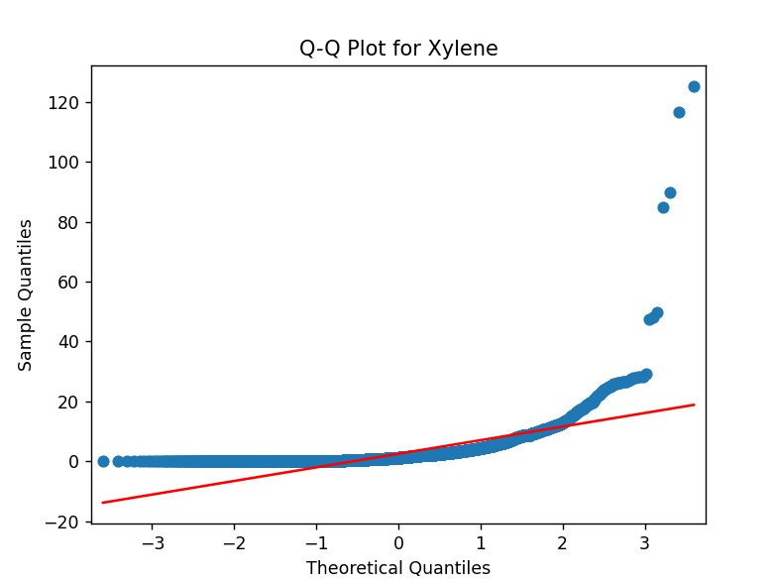
Q-Q Plots

Slide 25
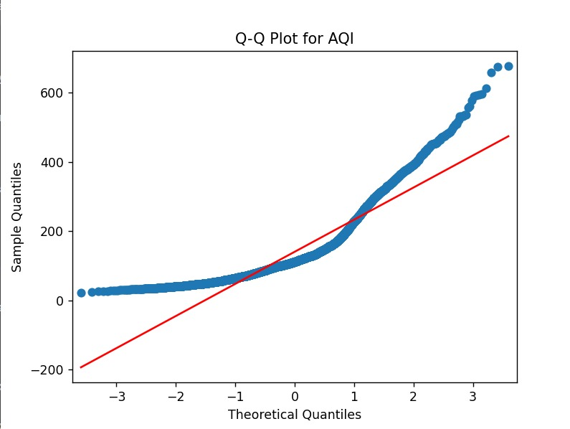
Q-Q Plots
Interpretation:
Upon visual inspection of the Q-Q plot, it is evident that the observed points deviate from the expected straight line, indicating not a normal distribution. This departure from normality may have implications for statistical analyses that assume normal distribution. Given these observations, alternative non-parametric or robust statistical methods may be considered for analyses where normality assumptions cannot be met.

Slide 26
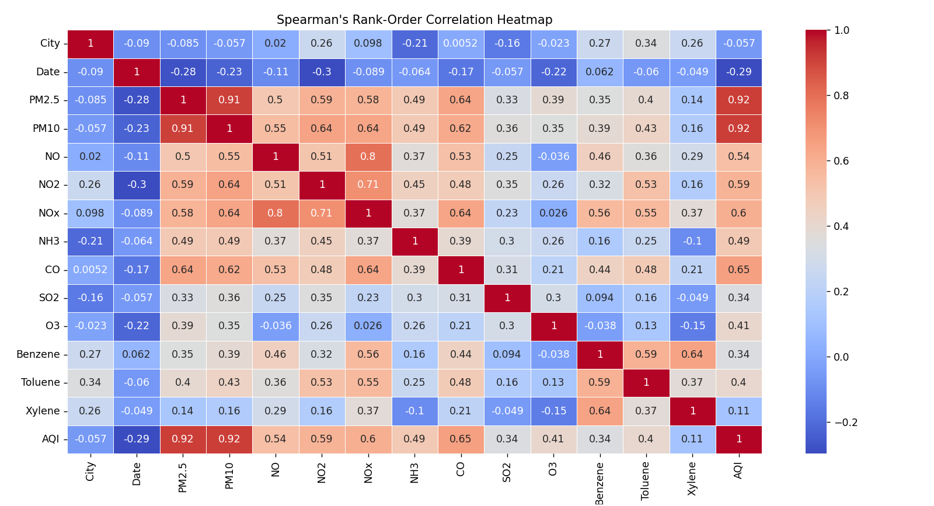
Correlation Test
Spearman Correlation:

Slide 27
Inference 2
ii)compare AQI year wise
We used the Kruskal-Wallis test as we have more than two independent samples and the assumption of normality is violated, making it a suitable non-parametric alternative to the one-way analysis of variance (ANOVA).

Slide 28
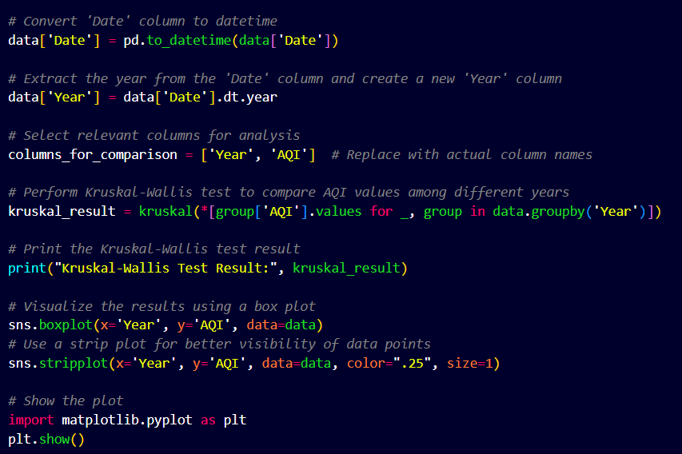
Inference 2
As p<0.05 we reject null hypothesis and conclude that there is significant difference in AQI over years.
Code for Kruskal-Wallis test

Slide 29
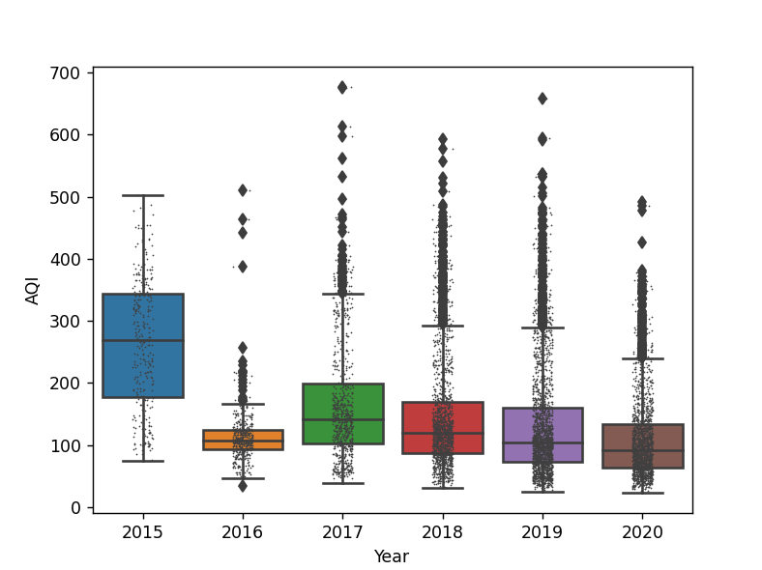
Inference 2

Slide 30
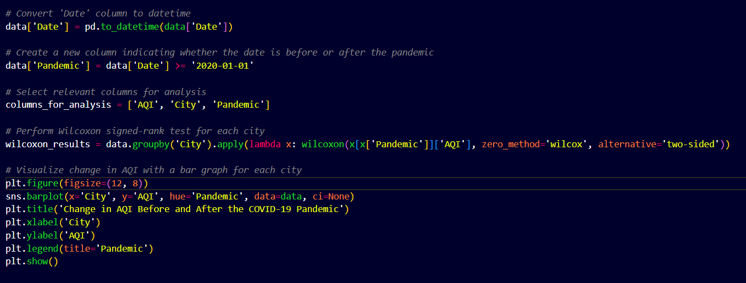
Inference 3
iii)Are there any notable trends in air quality improvements or deteriorations during the COVID-19 pandemic across the cities in the dataset?

Slide 31
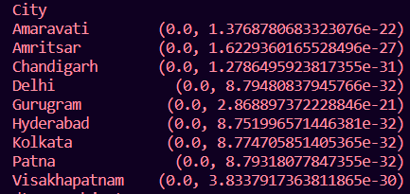
Inference 3
Here we have two dependent samples and data doesn’t follow normal distribution(non-parametric) hence we are using Wilcoxon signed-rank test.
As p-value ≤ 0.05 we reject the null hypothesis. This indicates that there is a significant difference in AQI values before and after the pandemic for all cities.

Slide 32
Conclusion
i) Correlation Between Attributes:
The analysis revealed significant correlations between various air quality attributes, providing insights into potential relationships among pollutants and overall air quality.
ii) Year-Wise Comparison of AQI:
Year-wise comparisons of Air Quality Index (AQI) across cities highlighted variations and trends in air quality over time. This information is crucial for understanding the temporal dynamics of air pollution.
iii) Impact of COVID-19 Pandemic on Air Quality:
The investigation into air quality changes during the COVID-19 pandemic demonstrated notable variations across cities. These findings contribute to understanding the influence of lockdowns and reduced human activities on air pollution levels.

Slide 33
ThankYou

